Slide 1

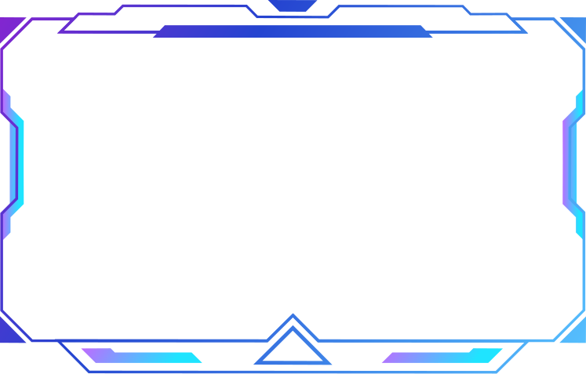










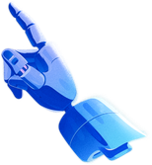

O
M
Orefile Mokoena
55881254
WEB DEVELOPER
OREFILE MOKOENA
Identity
I am a hardworking and disciplined individual who believes in responsibility, persistence, and continuous improvement. I value leadership and accountability, and I approach challenges with determination and a strong work ethic.
What I Care About
Family plays a major role in shaping who I am and motivates many of my goals. I care about trust, discipline, and building a future through consistent effort and personal growth.
WHAT I AM WORKING TOWARDS
Becoming a skilled professional cyber security specialist who builds meaningful systems and opportunities, achieving financial independence while creating stability and growth for myself and my family.
Logo Meaning
The interlocking O and M represent identity, structure, and connection.
Their link symbolises discipline, leadership, and the integration of my values, responsibilities, and ambitions as I build my future.
https://github.com/Godfrey-stack/CMPG-214_Designing-Yourselft

